Slide 1
Sorting Algorithms
RAGHU.H.V,
C-DAC, Bengaluru

Slide 2
Sorting Algorithms
Sorting is a process in which records are arranged in ascending or descending order.
The process of sorting is essential for database applications.
Real life example of sort :
In telephone directory the names of the subscribers and their phone numbers are written in alphabetical order. The records of the list of these telephone holders are to be sorted by their names.
Dictionary

Slide 3
Types Of Sorting Algorithm
Bubble Sort
Selection Sort
Insertion Sort
Quick Sort
Heap Sort
Merge Sort

Slide 4
Bubble Sort
Compare each element (except the last one) with its neighbor to the right
If they are out of order, swap them
This puts the largest element at the very end
The last element is now in the correct and final place
Compare each element (except the last two) with its neighbor to the right
If they are out of order, swap them
This puts the second largest element next to last
The last two elements are now in the correct and final place
Compare each element (except the last three) with its neighbor to the right
If they are out of order, swap them
This puts the third largest element next to second largest
The last three elements are now in their correct and final places
Continue as above until you have no unsorted elements on the left

Slide 5
Example of bubble sort
7
2
8
5
4
2
7
5
4
8
2
5
4
7
8
2
4
5
7
8
2
7
8
5
4
2
7
5
4
8
2
5
4
7
8
2
4
5
7
8
2
7
8
5
4
2
5
7
4
8
2
4
5
7
8
(done)
2
7
5
8
4
2
5
4
7
8
2
7
5
4
8

Slide 6
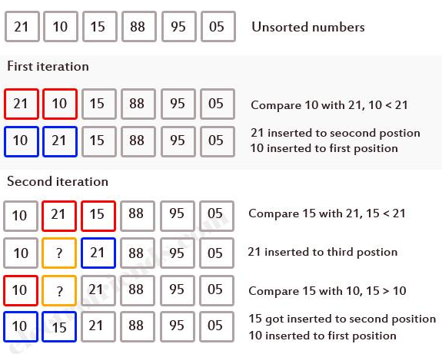
Insertion sort Demo

Slide 7
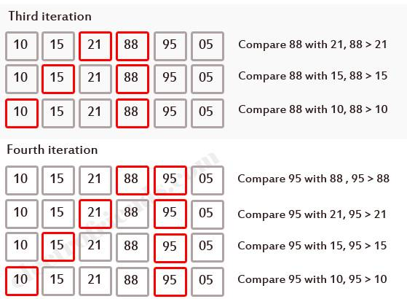
Insertion sort Demo Cont….

Slide 8
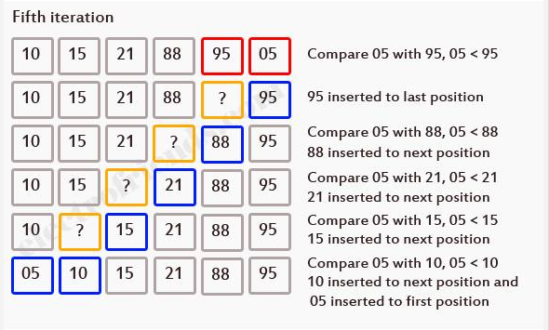
Insertion sort Demo Cont….

Slide 9
Selection Sort
Given an array of length n,
Search elements 0 through n-1 and select the smallest
Swap it with the element in location 0
Search elements 1 through n-1 and select the smallest
Swap it with the element in location 1
Search elements 2 through n-1 and select the smallest
Swap it with the element in location 2
Search elements 3 through n-1 and select the smallest
Swap it with the element in location 3
Continue in this fashion until there’s nothing left to search.

Slide 10
Example of selection sort
7
2
8
5
4
2
7
8
5
4
2
4
8
5
7
2
4
5
8
7
2
4
5
7
8

Slide 11
Quick Sort Algorithm
Given an array of n elements (e.g., integers):
If array only contains one element, return
Else
pick one element to use as pivot.
Partition elements into two sub-arrays:
Elements less than or equal to pivot
Elements greater than pivot
Quicksort two sub-arrays
Return results

Slide 12
QuickSort Example
We are given array of n integers to sort:
40
20
10
80
60
50
7
30
100

Slide 13
Pick Pivot Element
There are a number of ways to pick the pivot element.
In this example, we will use the first element in the array:
40
20
10
80
60
50
7
30
100

Slide 14
Partitioning Array
Given a pivot, partition the elements of the array such that the resulting array consists of:
One sub-array that contains elements > pivot
Another sub-array that contains elements <= pivot
The sub-arrays are stored in the original data array.
Partitioning loops through, swapping elements below/above pivot.

Slide 15
Example Explanation
pivot_index = 0
40
20
10
80
60
50
7
30
100
[0] [1] [2] [3] [4] [5] [6] [7] [8]
too_big_index
too_small_index

Slide 16
Example Explanation
While data[too_big_index] <= data[pivot]
++too_big_index
pivot_index = 0
40
20
10
80
60
50
7
30
100
[0] [1] [2] [3] [4] [5] [6] [7] [8]
too_big_index
too_small_index

Slide 17
Example Explanation
While data[too_big_index] <= data[pivot]
++too_big_index
pivot_index = 0
40
20
10
80
60
50
7
30
100
[0] [1] [2] [3] [4] [5] [6] [7] [8]
too_big_index
too_small_index

Slide 18
Example Explanation
While data[too_big_index] <= data[pivot]
++too_big_index
pivot_index = 0
40
20
10
80
60
50
7
30
100
[0] [1] [2] [3] [4] [5] [6] [7] [8]
too_big_index
too_small_index

Slide 19
Example Explanation
While data[too_big_index] <= data[pivot]
++too_big_index
While data[too_small_index] > data[pivot]
--too_small_index
pivot_index = 0
40
20
10
80
60
50
7
30
100
[0] [1] [2] [3] [4] [5] [6] [7] [8]
too_big_index
too_small_index

Slide 20
Example Explanation
While data[too_big_index] <= data[pivot]
++too_big_index
While data[too_small_index] > data[pivot]
--too_small_index
pivot_index = 0
40
20
10
80
60
50
7
30
100
[0] [1] [2] [3] [4] [5] [6] [7] [8]
too_big_index
too_small_index

Slide 21
Example Explanation
While data[too_big_index] <= data[pivot]
++too_big_index
While data[too_small_index] > data[pivot]
--too_small_index
If too_big_index < too_small_index
swap data[too_big_index] and data[too_small_index]
pivot_index = 0
40
20
10
80
60
50
7
30
100
[0] [1] [2] [3] [4] [5] [6] [7] [8]
too_big_index
too_small_index

Slide 22
Example Explanation
While data[too_big_index] <= data[pivot]
++too_big_index
While data[too_small_index] > data[pivot]
--too_small_index
If too_big_index < too_small_index
swap data[too_big_index] and data[too_small_index]
pivot_index = 0
40
20
10
30
60
50
7
80
100
[0] [1] [2] [3] [4] [5] [6] [7] [8]
too_big_index
too_small_index

Slide 23
Example Explanation
While data[too_big_index] <= data[pivot]
++too_big_index
While data[too_small_index] > data[pivot]
--too_small_index
If too_big_index < too_small_index
swap data[too_big_index] and data[too_small_index]
While too_small_index > too_big_index, go to 1.
pivot_index = 0
40
20
10
30
60
50
7
80
100
[0] [1] [2] [3] [4] [5] [6] [7] [8]
too_big_index
too_small_index

Slide 24
Example Explanation
While data[too_big_index] <= data[pivot]
++too_big_index
While data[too_small_index] > data[pivot]
--too_small_index
If too_big_index < too_small_index
swap data[too_big_index] and data[too_small_index]
While too_small_index > too_big_index, go to 1.
pivot_index = 0
40
20
10
30
60
50
7
80
100
[0] [1] [2] [3] [4] [5] [6] [7] [8]
too_big_index
too_small_index

Slide 25
Example Explanation
While data[too_big_index] <= data[pivot]
++too_big_index
While data[too_small_index] > data[pivot]
--too_small_index
If too_big_index < too_small_index
swap data[too_big_index] and data[too_small_index]
While too_small_index > too_big_index, go to 1.
pivot_index = 0
40
20
10
30
60
50
7
80
100
[0] [1] [2] [3] [4] [5] [6] [7] [8]
too_big_index
too_small_index

Slide 26
Example Explanation
While data[too_big_index] <= data[pivot]
++too_big_index
While data[too_small_index] > data[pivot]
--too_small_index
If too_big_index < too_small_index
swap data[too_big_index] and data[too_small_index]
While too_small_index > too_big_index, go to 1.
pivot_index = 0
40
20
10
30
60
50
7
80
100
[0] [1] [2] [3] [4] [5] [6] [7] [8]
too_big_index
too_small_index

Slide 27
Example Explanation
While data[too_big_index] <= data[pivot]
++too_big_index
While data[too_small_index] > data[pivot]
--too_small_index
If too_big_index < too_small_index
swap data[too_big_index] and data[too_small_index]
While too_small_index > too_big_index, go to 1.
pivot_index = 0
40
20
10
30
60
50
7
80
100
[0] [1] [2] [3] [4] [5] [6] [7] [8]
too_big_index
too_small_index

Slide 28
Example Explanation
While data[too_big_index] <= data[pivot]
++too_big_index
While data[too_small_index] > data[pivot]
--too_small_index
If too_big_index < too_small_index
swap data[too_big_index] and data[too_small_index]
While too_small_index > too_big_index, go to 1.
pivot_index = 0
40
20
10
30
60
50
7
80
100
[0] [1] [2] [3] [4] [5] [6] [7] [8]
too_big_index
too_small_index

Slide 29
Example Explanation
While data[too_big_index] <= data[pivot]
++too_big_index
While data[too_small_index] > data[pivot]
--too_small_index
If too_big_index < too_small_index
swap data[too_big_index] and data[too_small_index]
While too_small_index > too_big_index, go to 1.
pivot_index = 0
40
20
10
30
7
50
60
80
100
[0] [1] [2] [3] [4] [5] [6] [7] [8]
too_big_index
too_small_index

Slide 30
Example Explanation
While data[too_big_index] <= data[pivot]
++too_big_index
While data[too_small_index] > data[pivot]
--too_small_index
If too_big_index < too_small_index
swap data[too_big_index] and data[too_small_index]
While too_small_index > too_big_index, go to 1.
pivot_index = 0
40
20
10
30
7
50
60
80
100
[0] [1] [2] [3] [4] [5] [6] [7] [8]
too_big_index
too_small_index

Slide 31
Example Explanation
While data[too_big_index] <= data[pivot]
++too_big_index
While data[too_small_index] > data[pivot]
--too_small_index
If too_big_index < too_small_index
swap data[too_big_index] and data[too_small_index]
While too_small_index > too_big_index, go to 1.
pivot_index = 0
40
20
10
30
7
50
60
80
100
[0] [1] [2] [3] [4] [5] [6] [7] [8]
too_big_index
too_small_index

Slide 32
Example Explanation
While data[too_big_index] <= data[pivot]
++too_big_index
While data[too_small_index] > data[pivot]
--too_small_index
If too_big_index < too_small_index
swap data[too_big_index] and data[too_small_index]
While too_small_index > too_big_index, go to 1.
pivot_index = 0
40
20
10
30
7
50
60
80
100
[0] [1] [2] [3] [4] [5] [6] [7] [8]
too_big_index
too_small_index

Slide 33
Example Explanation
While data[too_big_index] <= data[pivot]
++too_big_index
While data[too_small_index] > data[pivot]
--too_small_index
If too_big_index < too_small_index
swap data[too_big_index] and data[too_small_index]
While too_small_index > too_big_index, go to 1.
pivot_index = 0
40
20
10
30
7
50
60
80
100
[0] [1] [2] [3] [4] [5] [6] [7] [8]
too_big_index
too_small_index

Slide 34
Example Explanation
While data[too_big_index] <= data[pivot]
++too_big_index
While data[too_small_index] > data[pivot]
--too_small_index
If too_big_index < too_small_index
swap data[too_big_index] and data[too_small_index]
While too_small_index > too_big_index, go to 1.
pivot_index = 0
40
20
10
30
7
50
60
80
100
[0] [1] [2] [3] [4] [5] [6] [7] [8]
too_big_index
too_small_index

Slide 35
Example Explanation
While data[too_big_index] <= data[pivot]
++too_big_index
While data[too_small_index] > data[pivot]
--too_small_index
If too_big_index < too_small_index
swap data[too_big_index] and data[too_small_index]
While too_small_index > too_big_index, go to 1.
pivot_index = 0
40
20
10
30
7
50
60
80
100
[0] [1] [2] [3] [4] [5] [6] [7] [8]
too_big_index
too_small_index

Slide 36
Example Explanation
While data[too_big_index] <= data[pivot]
++too_big_index
While data[too_small_index] > data[pivot]
--too_small_index
If too_big_index < too_small_index
swap data[too_big_index] and data[too_small_index]
While too_small_index > too_big_index, go to 1.
pivot_index = 0
40
20
10
30
7
50
60
80
100
[0] [1] [2] [3] [4] [5] [6] [7] [8]
too_big_index
too_small_index

Slide 37
Example Explanation
While data[too_big_index] <= data[pivot]
++too_big_index
While data[too_small_index] > data[pivot]
--too_small_index
If too_big_index < too_small_index
swap data[too_big_index] and data[too_small_index]
While too_small_index > too_big_index, go to 1.
pivot_index = 0
40
20
10
30
7
50
60
80
100
[0] [1] [2] [3] [4] [5] [6] [7] [8]
too_big_index
too_small_index

Slide 38
Example Explanation
While data[too_big_index] <= data[pivot]
++too_big_index
While data[too_small_index] > data[pivot]
--too_small_index
If too_big_index < too_small_index
swap data[too_big_index] and data[too_small_index]
While too_small_index > too_big_index, go to 1.
Swap data[too_small_index] and data[pivot_index]
pivot_index = 0
40
20
10
30
7
50
60
80
100
[0] [1] [2] [3] [4] [5] [6] [7] [8]
too_big_index
too_small_index

Slide 39
Example Explanation
While data[too_big_index] <= data[pivot]
++too_big_index
While data[too_small_index] > data[pivot]
--too_small_index
If too_big_index < too_small_index
swap data[too_big_index] and data[too_small_index]
While too_small_index > too_big_index, go to 1.
Swap data[too_small_index] and data[pivot_index]
7
20
10
30
40
50
60
80
100
pivot_index = 4
[0] [1] [2] [3] [4] [5] [6] [7] [8]
too_big_index
too_small_index

Slide 40
Partition Result
7
20
10
30
40
50
60
80
100
[0] [1] [2] [3] [4] [5] [6] [7] [8]
<= data[pivot]
> data[pivot]

Slide 41
Recursion: Quicksort Sub-arrays
7
20
10
30
40
50
60
80
100
[0] [1] [2] [3] [4] [5] [6] [7] [8]
<= data[pivot]
> data[pivot]

Slide 42
What is a “heap”?
Definitions of heap:
A large area of memory from which the programmer can allocate blocks as needed, and deallocate them (or allow them to be garbage collected) when no longer needed
A balanced, left-justified binary tree in which no node has a value greater than the value in its parent
These two definitions have little in common
Heapsort uses the second definition

Slide 43
The heap property
A node has the heap property if the value in the node is as large as or larger than the values in its children
12
12
12
8
3
8
12
8
14
Blue node has heap property
Blue node has heap property
Blue node does not have heap property
All leaf nodes automatically have the heap property
A binary tree is a heap if all nodes in it have the heap property

Slide 44
shiftUp
Given a node that does not have the heap property, you can give it the heap property by exchanging its value with the value of the larger child
12
14
8
14
8
12
Blue node does not have heap property
Blue node has heap property
This is sometimes called shifting up
Notice that the child may have lost the heap property

Slide 45
Constructing a heap
8
8
10
10
10
8
8
5
1
2
3
10
10
12
8
5
12
5
10
5
12
8
8
4

Slide 46
Constructing a heap Cont….
12
12
14
10
5
14
5
12
5
8
14
8
10
8
10

Slide 47
A sample heap
Here’s a sample binary tree after it has been heapified
25
22
17
19
22
14
15
18
14
21
3
9
11
Notice that heapified does not mean sorted
Heapifying does not change the shape of the binary tree; this binary tree is balanced and left-justified because it started out that way

Slide 48
Removing the root
Notice that the largest number is now in the root
Suppose we discard the root:
11
22
17
19
22
14
15
18
14
21
3
9
11
How can we fix the binary tree so it is once again balanced and left-justified?
Solution: remove the rightmost leaf at the deepest level and use it for the new root

Slide 49
The reHeap method
Our tree is balanced and left-justified, but no longer a heap
However, only the root lacks the heap property
11
22
17
19
22
14
15
18
14
21
3
9
We can siftUp() the root
After doing this, one and only one of its children may have lost the heap property

Slide 50
The reHeap method Cont….
Now the left child of the root (still the number 11) lacks the heap property
22
11
17
19
22
14
15
18
14
21
3
9
We can siftUp() this node
After doing this, one and only one of its children may have lost the heap property

Slide 51
The reHeap method Cont….
Now the right child of the left child of the root (still the number 11) lacks the heap property:
22
22
17
19
11
14
15
18
14
21
3
9
We can siftUp() this node
After doing this, one and only one of its children may have lost the heap property —but it doesn’t, because it’s a leaf

Slide 52
The reHeap method Cont….
Our tree is once again a heap, because every node in it has the heap property
22
22
17
19
21
14
15
18
14
11
3
9
Once again, the largest (or a largest) value is in the root
We can repeat this process until the tree becomes empty
This produces a sequence of values in order largest to smallest

Slide 53
Sorting
What do heaps have to do with sorting an array?
Here’s the neat part:
Because the binary tree is balanced and left justified, it can be represented as an array
All our operations on binary trees can be represented as operations on arrays
To sort:
heapify the array;
while the array isn’t empty {
remove and replace the root;
reheap the new root node; }

Slide 54
The End

